Slide 1
Lecture 7
Missing Data and Imputation
Instructor: Hamed Hasheminia

Slide 2
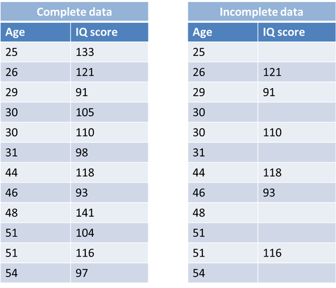
Missing Data

Slide 3
Ignoring or inappropriately handling missing data may lead to…
Biased estimates
Incorrect standard errors
Incorrect inferences/results

Slide 4
Missing Data Mechanisms
Missing Completely at Random (MCAR)
Dropping unobserved observations is fine!
Missing at Random (MAR): Missingness depends on observed data
E.g., women more likely to respond to men
Can use weighting or imputation approaches to deal with the missingness
Usually people try to solve this type of missing data issue
Not missing at random (NMAR): Missingness depends on unobserved values
Probability of reporting psychiatric treatment depends on whether or not they have received it
Probability of someone reporting their income depends on what their income is
No easy way to deal with that!
Notes:
1. How can you tell if it is random? Drop them. Standard error will be slightly lower (70%<<??) . 2. MAR, solve by imputation. Depemds on something inside dataset. 3. depends on external something.

Slide 5
Improper ways of handing missing Data!
Ignoring it
Ignore it; just run models without doing anything about missingness
You only rely on defaults of the software
Complete Case (listwise deletion)
Restricts the analysis to only observed data
Assumes missingness is MCAR
Lowers the power of your models
Generally leads to biased results

Slide 6
Improper ways of handing missing Data!
Single Imputation (Fill in (“impute”) each missing value
Mean/Median/fill backward/fill forward
Regression Prediction (“Conditional Mean Imputation”)
Impute mean within categories of observed covariates (gender, race, etc.)
Fit regression model among observed cases, use to predict response for individuals with missing values
Notes:
Weights observed variables, over emphasizing these

Slide 7
Slightly better ways of handing missing Data!
“Hot-deck”
for an individual with missing data, find individuals with the same observed values on other variables, randomly pick one of their values as the one to use for imputation
Regression Prediction plus error (“Stochastic regression imputation”)
Same as regression imputation – you just add random error to it.

Slide 8
Summary of single imputation approaches
among those discussed, the best are regression prediction plus error or hot-deck (based on categorical versions of all the variables observed)
Can be reasonable if you have few missing data ( < 5%)
BUT .. Results in overly precise estimates
Simply treats all of the values as observed values
So does not take into account the uncertainty in the imputations.
What should we do instead?

Slide 9
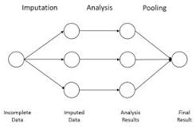
Appropriate ways of handling missing values
Weighting
Multiple Imputation
Maximum Likelihood (FIML) * Above the scope of this class
OUR GOAL IS NOT TO GET CORRECT PREDICTIONS OF MISSING VALUES; GOALS IS TO OBTAIN ACCURATE PARAMETER ESTIMATES FOR RELATIONSHIPS OF INTEREST
Notes:
Instead of creating one dataset, then pool results

Slide 10
Nonresponse Weighting
Often used to deal with Attrition
Generate model predicting response given observed covariates
Weight Respondent by their inverse probability of response
Weights the respondents up to represent the full sample
Same idea as survey sampling weight
Use Analysis methods that allow for weights
Works well for simple missing data patterns (e.g. Attrition)

Slide 11
Nonresponse Weighting
A simple example …
Imagine 100 males and 100 females in sample
But only 80 males and 75 females respond
Male respondents will get weight of 100/80 = 1.25
Female respondents will get weights of 100/75 = 1.33

Slide 12
Multiple Imputation
Same idea as single imputation, but fills in each missing value multiple times
Like repeating the stochastic mean imputation multiple times
Creates multiple (e.g., 100) “complete” data sets
Analyses then run separately on each dataset and result combined across datasets

Slide 13
Summary
We have three types of missing data MCAR, MAR, NMAR
For MCAR – we can simply drop missing data
For MAR we can use single imputation or multiple imputation methods. It is highly recommended that you use multiple imputation methods – unfortunately, standard libraries in python do not handle this properly.
For NMAR, there is no known way to handle missing data.

Slide 14
Acknowledgment
Most of today’s lecture is extracted from Lecture notes of Dr. Elizabeth A. Stuart

